Slide 1
Building Applications for Office 365 and SharePoint with the SharePoint Framework
Scot Hillier
scot@scothillier.net
@ScotHillier

Slide 2
Agenda
Enterprise JavaScript
Overview and Development Environment
Classes and Modules
TypeScript
React Framework
Fundamentals
Lifecycle and Async Operations
SharePoint Framework
Overview and Development Environment
Building Client Web Parts

Slide 3
Enterprise javascript
Overview and Development Environment

Slide 4
Overview
Environments
Visual Studio 2017
Visual Studio Code
Tools and Technologies
Node JS
Node Package Manager (NPM)
TypeScript

Slide 5
Development Environment
Visual Studio 2017
TypeScript 2.2 npm install -g typescript
Node
Node.js https://nodejs.org/en/
SharePoint Framework npm i -g yo gulp
npm i -g @microsoft/generator-sharepoint

Slide 6
DEMO
Key Tools and Resources

Slide 7
Enterprise JavaScript
Classes and Modules

Slide 8
ECMAScript 2015
Compatibility
Varying levels of support
https://kangax.github.io/compat-table/es6/
Features
http://es6-features.org
arrows | classes | enhanced object Literals | template literals
destructuring | default, rest, spread | let, const | iterators
generators | unicode | modules, loaders | map, set
proxies | symbols | built-ins | promises
object APIs | literals | reflection | tail calls

Slide 9
Classes
class person {
constructor(firstName, lastName) {
this.firstName = firstName;
this.lastName = lastName;
}
speak() {
return `My name is ${this.firstName} ${this.lastName}.`;
}
}
var p = new person('Scot', 'Hillier');
alert(p.speak());

Slide 10
Inheritance
class customer extends person {
constructor(firstName, lastName, title, company, email) {
super(firstName, lastName)
this.title = title;
this.company = company;
this.email = email;
}
talk() {
return `${super.speak()} I work for ${this.company}.`;
}
}
var c = new customer('Scot', 'Hillier', 'MVP',
'IT Unity', 'scot@scothillier.net');
alert(c.talk());

Slide 11
Modules
Internal
Used to encapsulate code
Prevents global namespace pollution
Loaded through a Script tag
External
Small units of independent, reusable code
Supports the pattern of “component” development
Loaded using an async module loader component

Slide 12
Internal Module
//namespace
var Wingtip = window.Wingtip || {};
Wingtip.Customer = function () {
//private members
var name,
setname = function (n) { name = n; },
getname = function () { return name; },
talk = function () { alert("My name is " + name); };
//public interface
return {
set_name: setname,
get_name: getname,
speak: talk
}
}();
Wingtip.Customer.speak();

Slide 13
External Modules
ES2015 Modules
Supports export/import without polluting global namespace
Current ECMAScript 5 support
CommonJS format used with node.js server
AMD format with require.js in browser
UMD format is compatible with AMD, CommonJS and no loader at all
JavaScript Loader standard
Attempting to standardize loading behavior
WebPack
Bundles modules and dependencies

Slide 14
ES2015 Declarative module usage
//requires a transpiler or polyfill today
//person.js
export class Person {
constructor(firstName, lastName) {
this.firstName = firstName;
this.lastName = lastName;
}
}
//app.js
import {Person} from 'person';
let p = new Person();

Slide 15
ES2015 dynamic module loading
//requires a transpiler or polyfill today
//person.js
export class Person {
constructor(firstName, lastName) {
this.firstName = firstName;
this.lastName = lastName;
}
}
//app.js
System.import('person').then(Person => {
let p = new Person();
}).catch(error => {
alert(error);
});

Slide 16
AMD modules with require.js
//index.html
<script src="/Scripts/require.js" data-main="/Scripts/app"></script>
//app.js
define(["require", "exports", "customer"], function (customer) {
alert(customer.speak());
});
//customer.js
define(["require", "exports"], function (require, exports) {
var Customer = (function () {
function Customer(fn, ln) {
this.firstName = fn;
this.lastName = ln;
}
Customer.prototype.speak = function () {
return "My name is " + this.firstName + " " + this.lastName;
};
return Customer;
})();
exports.Customer = Customer;
});

Slide 17
ES2015 module loader polyfill
<script src="traceur.js"></script>
<script src="es6-module-loader-dev.js"></script>
<!-- type="module" invokes the Google traceur transpiler on that code -->
<!-- System.import support is provided by the es6-module-loader -->
<script type="module">
System.import('app/module1.js').then(function (module1) {
let p = module1.Person('Scot', 'Hillier');
alert(p.speak());
}).catch(function (err) {
alert(err);
});
</script>

Slide 18
Register modules with system.js
<script src="system.js"></script>
<!–- built on top of the es6-module-loader polyfill -->
<!–- loads any module format, invokes transpiler if necessary -->
<script>
System.config({
packages: {
'app': {
format: 'register',
defaultExtension: 'js'
}
}
});
System.import('app/myModule')
.then(null, console.error.bind(console));
</script>

Slide 19
Bundle Modules with WebPack
//message.js
module.exports = "Hello, webpack!";
//content.js
module.exports = "<p style='color:blue'>" +
require("./message.js") + "</p>";
//server.js
var http = require('http');
var port = process.env.port || 1337;
http.createServer(function (req, res) {
res.writeHead(200, { 'Content-Type': 'text/html' });
res.end(require('./content.js'));
}).listen(port);
webpack ./server.js bundle.js
bundle.js

Slide 20
DEMO
Classes, Modules, and Bundling

Slide 21
Enterprise JavaScript
TypeScript

Slide 22
Introduction to TypeScript
Typed superset that transpiles to plain JavaScript
You write .ts files and it compiles to .js files
Cross-browser compatible
Integrated into Visual Studio 2017
Compilation
Intellisense
Key Features
Static typing
ES6/7 Support now

Slide 23
Static Typing
private getQueryStringParameter(p: string): string { ... };
scope
Input type
Return type
private displayName: string = "Scot";
Supported Types
boolean
number
string
Array<T>
enum
any
void
scope
type

Slide 24
Classes
class Welcome {
//private members
private displayName: string = "Scot Hillier";
private pictureUrl: string = "/images/sh.jpg";
//public methods
public get_viewModel() {
return {
"pictureUrl": this.pictureUrl,
"displayName": this.displayName
};
}
}

Slide 25
Interfaces
interface WelcomeData {
pictureUrl: string;
displayName: string;
}
class Welcome {
public get_viewModel(): WelcomeData {
return {
"pictureUrl": this.pictureUrl,
"displayName": this.displayName
};
}
}
Define Interface
Implement Interface

Slide 26
Internal Modules
//define module
module Wingtip {
export class Welcome {
private displayName: string = "Scot Hillier";
private pictureUrl: string = "/images/sh.jpg";
public get_viewModel() {
return {
"pictureUrl": this.pictureUrl,
"displayName": this.displayName
};
}
}
}
//use module
var vm = new Wingtip.Welcome();

Slide 27
External Modules
//wingtip.ts
export module Wingtip {
export class Welcome {
private displayName: string = "Scot Hillier";
private pictureUrl: string = "/images/sh.jpg";
public get_viewModel() {
return {
"pictureUrl": this.pictureUrl,
"displayName": this.displayName
};
}
}
}
//app.ts
import {Wingtip} from 'wingtip'
var vm = new Wingtip.Welcome();

Slide 28
Type Definition Files
Supports the use of external libraries
Provides intellisense in TypeScript environment
Takes the form of a *.d.ts file
Available “@types” NPM packages
npm install @types/sharepoint -dev--save

Slide 29
DEMO
TypeScript

Slide 30
REACT Framework
Fundamentals

Slide 31
Introducing React
React is a framework for building user interfaces
The framework reacts to state changes in the UI
Emphasizes component-based development
Lighter than other frameworks
Ideal for building web parts

Slide 32
React Fundamentals
Obtain the framework from a CDN or npm
https://cdnjs.cloudflare.com/ajax/libs/react/15.5.4/react.min.js
https://cdnjs.cloudflare.com/ajax/libs/react/15.5.4/react-dom.min.js
npm install react --save
npm install react-dom --save
React is the main entry point to APIs
ReactDOM used to render elements
React.DOM wraps standard HTML elements

Slide 33
Hello, World
<!DOCTYPE html>
<html>
<head>
<meta charset="utf-8" />
<title>React JavaScript Basics</title>
</head>
<body>
<div id="app"></div>
<!-- React Libraries -->
<script src="https://cdnjs.cloudflare.com/ajax/libs/react/15.5.4/react.min.js"></script>
<script src="https://cdnjs.cloudflare.com/ajax/libs/react/15.5.4/react-dom.min.js"></script>
<script>
ReactDOM.render(React.DOM.h1(null, "Hello, React!"), document.getElementById("app"));
</script>
</body>
</html>
React.DOM contains HTML components
ReactDOM allows rendering of HTML

Slide 34
React Components
A custom class extending React.Component
Render method returns a React component
Immutable props for component configuration
Changeable state used to render component

Slide 35
ES5 Component
var Component = React.createClass(
{
propTypes: { message: React.PropTypes.string },
getDefaultProps: function() { return { message: "I don't know what to say!" }},
getInitialState: function() { return { text: this.props.message}},
updateTextState: function(newText) { this.setState({ text: "Thank you!" })},
render: function () {
return React.DOM.h1({onClick: this.updateTextState}, this.state.text);
}
}
);
ReactDOM.render(
React.createElement(Component,
{ message: "Click on my first component" }), document.getElementById("app"));

Slide 36
ES2015 Component
class Component extends React.Component {
constructor(props) {
super(props);
this.state = { text: props.message };
this.updateTextState = this.updateTextState.bind(this);
}
render() { return React.DOM.h1(
{ onClick: this.updateTextState },
this.state.text); }
updateTextState(newText) { this.setState({ text: "Thank you!" }); }
}

Slide 37
Event Handling
constructor(props: IMyProps){
super(props);
this.state.value = props.value;
this.changed = this.changed.bind(this);
}
public render(): React.ReactElement<any> {
return (<div className={ this.className }>
<input onChange={this.changed} type="text“
value={this.state.value} />
</div>);
}
public changed(event): void {
var newValue: string = event.target.value;
event.stopPropagation();
event.nativeEvent.stopImmediatePropagation();
}
Be sure to bind ‘this’
Designate handler
Implement handler
Stop bubbling
Stop other handlers

Slide 38
Utilizing JSX
JSX is a preprocessor step that adds XML syntax to JavaScript
It is optional, but very useful for organizing components
It requires a transpiler like Babel or TypeScript
The following are equivalent:
ReactDOM.render(
React.createElement(Component, { message: "My first component" }),
document.getElementById("app"));
ReactDOM.render(
<Component message="My first component" />,
document.getElementById("app"));

Slide 39
DEMO
React Fundamentals

Slide 40
React Framework
Lifecycle and Async Operations

Slide 41
Component Lifecycle
componentWillUpdate
executed before component is rendered
componentDidUpdate
executed after component is rendered
componentWillMount
executed before node is added to the DOM
componentDidMount
executed after node is added to the DOM
componentWillUnmount
executed before node is removed from the DOM
shouldComponentUpdate(newProps, newState)
executed before component is updated

Slide 42
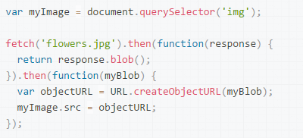
fetch()
Promise-based network requests
Supported natively by Chrome 49 and above
Supported by TypeScript for other browsers

Slide 43
Asychronous Calls and State Update
public componentDidMount(): void {
fetch(
'../../_api/web/currentuser',
{
method: 'GET',
credentials: 'same-origin',
headers: {
'accept': 'application/json'
}
}
).then(response => {
return response.json();
}).then(json => {
console.log(json);
this.setState({ data: json.Title, isValid: true });
}).catch(e => {
console.log(e);
});
}
Critical for SharePoint

Slide 44
DEMO
Lifecycle, and Async Operations

Slide 45
SharePoint framework
Overview and Development Environment

Slide 46
SharePoint Development Models
Full-Trust Code
Sandboxed Solutions
App/Add-In Model
Embedded JavaScript
SharePoint Framework

Slide 47
Development Environment
Office 365 Tenancy
Office Developer Program
App Catalog Developer Site Collection
Upload SharePoint Workbench
Visual Studio 2015
Complete previous setup steps Yeoman Generator, Gulp, and SharePoint Generator
npm install -g yo gulp
npm i -g @microsoft/generator-sharepoint

Slide 48
SharePoint framework
Building Client Web Parts

Slide 49
SharePoint Framework
Open source client-side UX
Responsive and mobile
Supports any JavaScript framework

Slide 50
Key Concepts
Codifies the JavaScript embed pattern
Runs in the context of the current user
Hosted in a referenced CDN
Works with new page experience or classic page experience
Feature Pack 2 will support on-premises development

Slide 51
Development Flow
Generate Scaffolding
Package
Write Code
Deploy to CDN
Test in local Workbench
Upload to App Catalog
Test in SP Workbench
App Web Part to Page

Slide 52
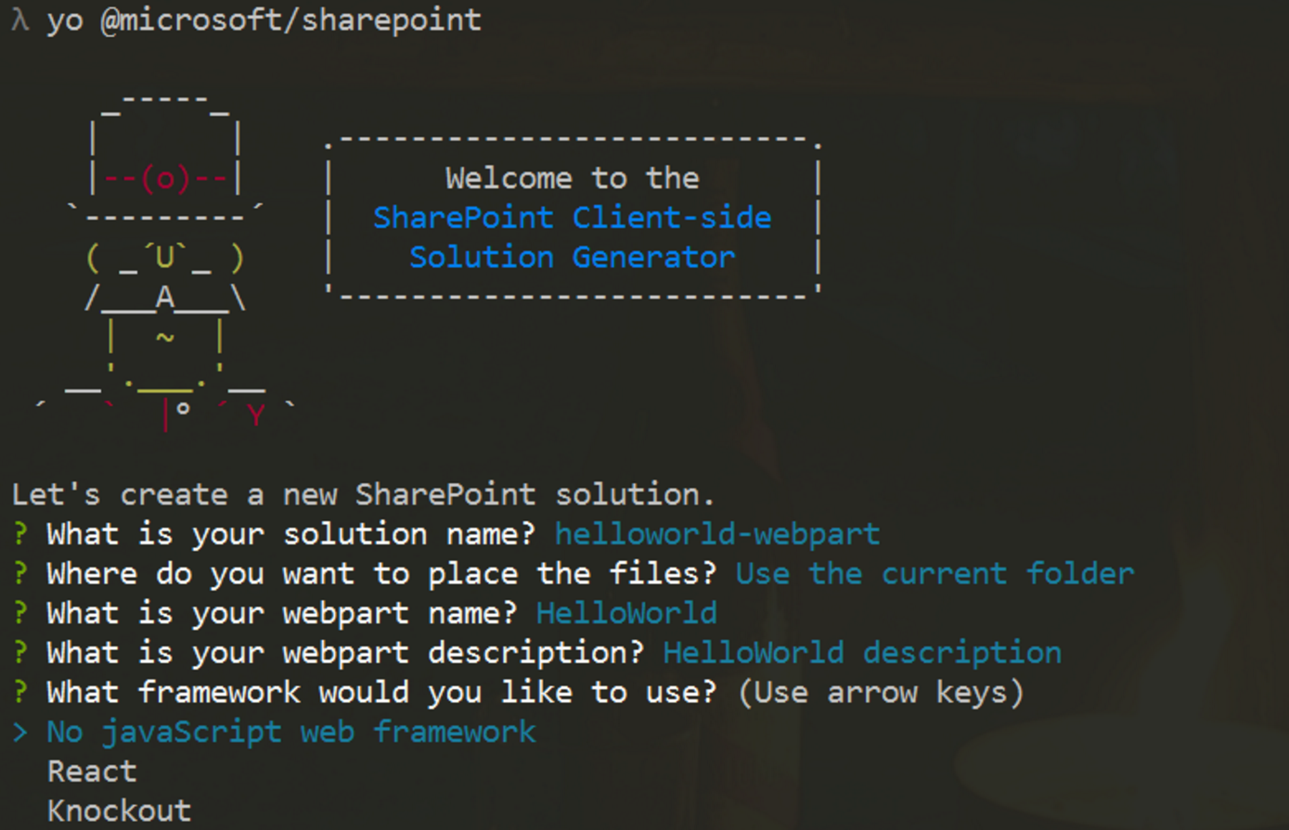
Generate Scaffolding
Yeoman Generator
Creates initial project files
React and KO built-in
Angular requires manual steps
yo @microsoft/sharepoint
Visual Studio Code
Open created project for editing

Slide 53
Write Code
export default class MyFirstKoWebPartWebPart extends
BaseClientSideWebPart<IMyFirstKoWebPartWebPartProps> {}
Framework extends a react js component to render HTML output
public render(): void {
}

Slide 54
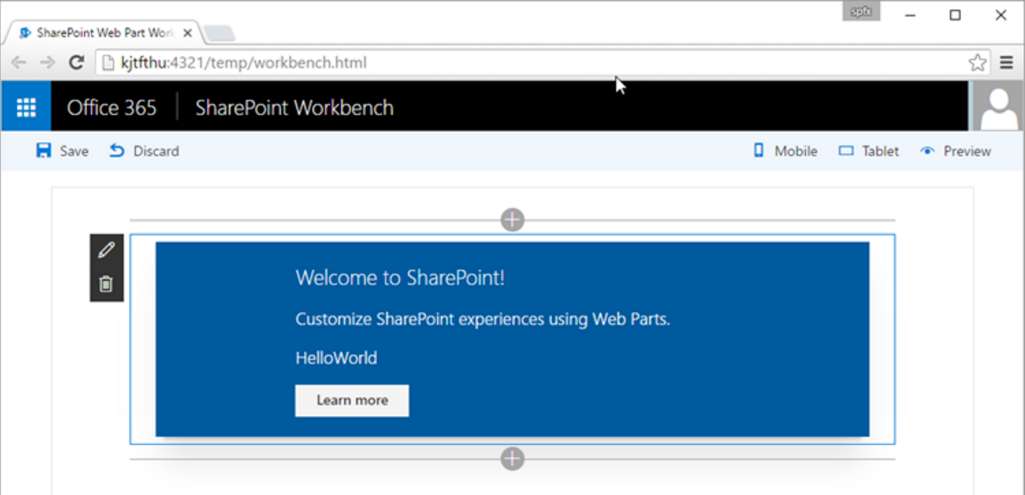
Test in Workbench
Local
For local testing
Office 365
Runs in the SharePoint context

Slide 55
Build Tasks
Gulp tasks defined in @microsoft/sp-build-core-tasks
build
bundle
serve
nuke
test
package-solution
deploy-azure-storage

Slide 56
Deployment
CDN Support
gulp package-solution
Deploy assets to CDN from directory in prepare-deploy.json file
Reference in write-manifests.json file
SharePoint
Create SPAPP package
Upload to App Catalog
Add to App and Web Part to site
"deployCdnPath": "temp/deploy"
"cdnBasePath": "https://[MYOFFICE365].sharepoint.com/SiteAssets/"

Slide 57
DEMO
Building Client Web Parts

Slide 58
Summary
Enterprise JavaScript
Overview and Development Environment
Classes and Modules
TypeScript
React Framework
Fundamentals
Lifecycle and Async Operations
SharePoint Framework
Overview and Development Environment
Building Client Web Parts

Slide 59
Questions?
Please use Events XD (EventBoard) to fill out a session evaluation.
Thank you!

